Slide 1
Computer Modeling and Simulation
By
Sara Rehmat
MS(CS)

Slide 2
Background
Random variable X is a variable whose value is defined as the outcome of a random phenomenon.
A random process (also called stochastic process)is a collection of random variables indexed by a set T that often represent different instants of time. The

Slide 3
Types of Random Variables
The random variables at different instant of time can be independent to each other (coin flipping example) or dependent in some way (stock price example)
The random variables can

Slide 4
Random Process
A random process is a time-varying function that assigns the outcome of a random experiment to each time instant: X(t).

Slide 5
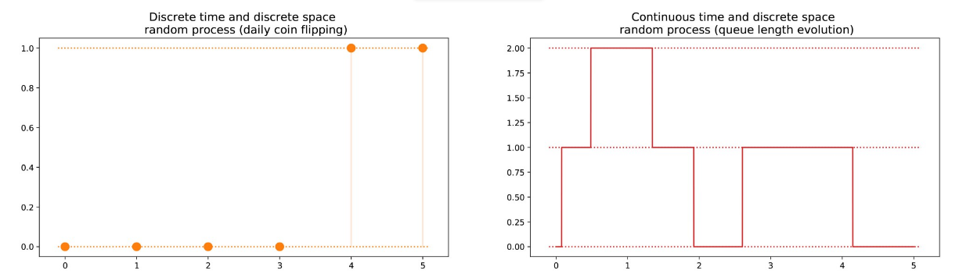
Types of Random Processes

Slide 6
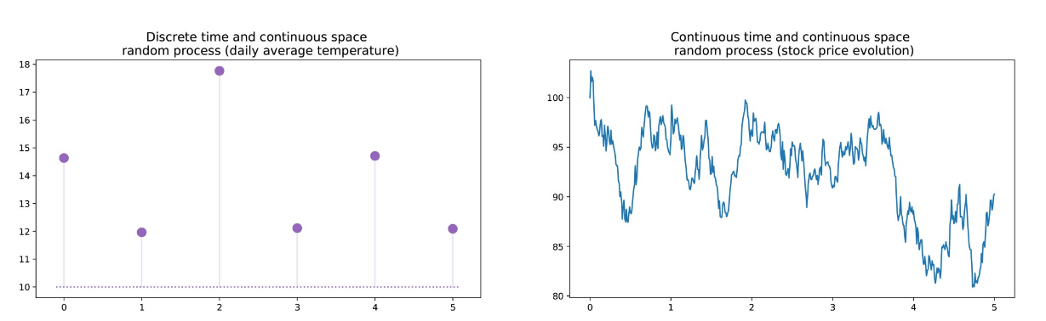
Types of Random Process

Slide 7
Markov Property of Random Process
The Markov property says, for a random process, that if we know the value taken by the process at a given time, we won’t get any additional information about the future behaviour of the process by gathering more knowledge about the past.
Stated in slightly more mathematical terms, for any given time, the conditional distribution of future states of the process given present and past states depends only on the present state and not at all on the past states .
The above is called memoryless property.
A random process with the Markov property is called Markov process

Slide 8
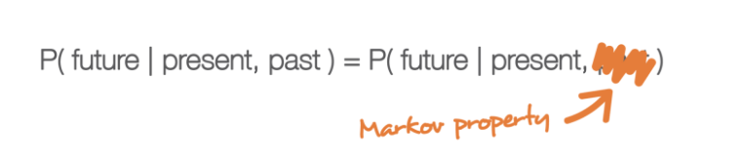
Markov Chain
A Markov chain is a Markov process with discrete time and discrete state space.

Slide 9


Mathematical Representation of Markov Property
Mathematically, we can denote a Markov chain by
where at each instant of time the process takes its values in a discrete set E such that
Then, the Markov property implies that we have

Slide 10
This last formula expresses the fact that for a given historic (where I am now and where I was before), the probability distribution for the next state (where I go next) only depends on the current state and not on the past states.

Slide 11

Instantiation of Markov Chain
Let’s now see what we do need in order to define a specific “instance” of such a random process.
we only need to specify two things: an initial probability distribution (that is a probability distribution for the instant of time n=0) denoted

Slide 12

Instantiation of Markov Chain
and a transition probability kernel (that gives the probabilities that a state, at time n+1, succeeds to another, at time n, for any pair of states) denoted

Slide 13
Applications
Markov Chains have usage in mathematics, economics, game theory, communication theory, genetics and finance.
When it comes to real-world problems, they are used to postulate solutions to study cruise control systems in motor vehicles, queues or lines of customers arriving at an airport, exchange rates of currencies, etc.
The algorithm known as PageRank, which was originally proposed for the internet search engine Google, is based on a Markov process.
Reddit's Subreddit Simulator is a fully-automated subreddit that generates random submissions and comments using markov chains, so cool!

Slide 14
Representation of Markov Chain
A Markov chain is represented using a probabilistic automaton.
The changes of state of the system are called transitions.
The probabilities associated with various state changes are called transition probabilities.
A probabilistic automaton includes the probability of a given transition into the transition function, turning it into a transition matrix.
You can think of it as a sequence of directed graphs, where the edges of graph n are labeled by the probabilities of going from one state at time n to the other states at time n+1, Pr(X_{n+1} = x | X_{n} = x_{n}). You can read this as, probability of going to state X_{n+1} given value of state X_{n}.
The same information is represented by the transition matrix from time n to time n+1. Every state in the state space is included once as a row and again as a column, and each cell in the matrix tells you the probability of transitioning from its row's state to its column's state.

Slide 15
Representation of Markov Chain
If the Markov chain has N possible states, the matrix will be an N x N matrix, such that entry (I, J) is the probability of transitioning from state I to state J. Additionally, the transition matrix must be a stochastic matrix, a matrix whose entries in each row must add up to exactly 1. Why? Since each row represents its own probability distribution.
So, the model is characterized by a state space, a transition matrix describing the probabilities of particular transitions, and an initial state across the state space, given in the initial distribution.

Slide 16
Example
When Cj is sad, which isn't very usual: she either goes for a run, goobles down icecream or takes a nap.
From historic data, if she spent sleeping a sad day away. The next day it is 60% likely she will go for a run, 20% she will stay in bed the next day and 20% chance she will eat icecream.
When she is sad and goes for a run, there is a 60% chances she'll go for a run the next day, 30% she gorges on icecream and only 10% chances she'll spend sleeping the next day.
Finally, when she indulges on icecream on a sad day, there is a mere 10% chance she continues to have icecream the next day as well, 70% she is likely to go for a run and 20% chance that she spends sleeping the next day.

Slide 17
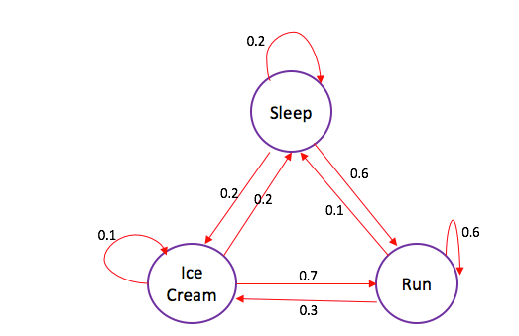
Graphical Representation of Markov Chain

Slide 18
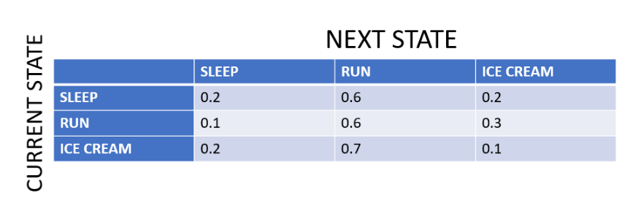
Transition Matrix

Slide 19
With the example that you have seen, you can now answer questions like: "Starting from the state: sleep, what is the probability that Cj will be running (state: run) at the end of a sad 2-day duration?"
Let's work this one out: In order to move from state: sleep to state: run, Cj must either stay on state: sleep the first move (or day), then move to state: run the next (second) move (0.2 ⋅ 0.6); or move to state: run the first day and then stay there the second (0.6 ⋅ 0.6) or she could transition to state: icecream on the first move and then to state: run in the second (0.2 ⋅ 0.7). So the probability: ((0.2 ⋅ 0.6) + (0.6 ⋅ 0.6) + (0.2 ⋅ 0.7)) = 0.62. So, we can now say that there is a 62% chance that Cj will move to state: run after two days of being sad, if she started out in the state: sleep.

Slide 20
Imagine that there were two possible states for weather: sunny or cloudy.
You can always directly observe the current weather state, and it is guaranteed to always be one of the two aforementioned states.
Now, you decide you want to be able to predict what the weather will be like tomorrow.
Intuitively, you assume that there is an inherent transition in this process, in that the current weather has some bearing on what the next day’s weather will be. So, being the dedicated person that you are, you collect weather data over several years, and calculate that the chance of a sunny day occurring after a cloudy day is 0.25. You also note that, by extension, the chance of a cloudy day occurring after a cloudy day must be 0.75, since there are only two possible states.
You can now use this distribution to predict weather for days to come, based on what the current weather state is at the time.

